Slide 1
Trosolwg dros data y gweithlu addysg ôl 16
Data overview of the post 16 education workforce
Nia Griffith – Rheolwr Data/Data Manager

Slide 2
Trosolwg o’r Sesiwn
Session Overview
Cefndir y Gofrestr a data ar gyfer y grwpiau cofrestredig
Data
  Athrawon Addysg Bellach
  Gweithwyr Cymorth Dysgu Addysg Bellach
  Ymarferwyr Dysgu Seiliedig ar Waith
Asesiad Data a Bynciau Addysg Bellach
Cloi
Cwestiwn a Ateb
Background of the Register and the data for the registered groups
Data
  Further Education Teachers
  Further Education Learning Support Workers
  Work-Based Learning Practitioners
Data Analysis on FE Subjects
Closing remarks
Q&A

Slide 3
Nifer yr ymarferwyr sy’n gymwys i weithio ym mhob categori (Mawrth 202)
Number of practitioners eligible to work in each category (March 2024)
Gweithwyr ieuenctid 0.4%
423
Youth workers 0.4%
Gweithwyr cymorth ieuenctid 0.7%
699
Youth support workers 0.7%
Ymarferwyr dysgu seiliedig ar waith 3.4%
3,533
Work-based learning practitioners 3.4%
Gweithwyr cymorth dysgu AB 6.3%
6,504
FE learning support workers 6.3%
Athrawon AB 6.5%
6,786
FE teachers 6.5%
Athrawon ysgol 36.3%
37,682
School teachers 36.3%
Cymorthwyr dysgu ysgol 46.4%
48,079
Learning support workers 46.4%

Slide 4
Athrawon Addysg Bellach
Further Education Teachers

Slide 5
Demograffeg
Demographics
Grwp Ethnig | 2024
 | Nifer / Number | %
Gwyn / White | 5,363 | 80.0
Cymysg neu nifer o grwpiau ethnig / Mixed or multiple ethnic groups | 48 | 0.7
Asiaidd neu Asiaidd Prydeinig / Asian or Asian British | 106 | 1.6
Du, Affricanaidd, Caribїaidd neu Du Prydeinig / Black, African, Caribbean or Black British | 65 | 1.0
Grwp ethnig arall / Other ethnic groups | 40 | 0.6
Ddim eisiau ei gofnodi / Do not wish to disclose | 187 | 2.8
Anhysbus / Unknown | 893 | 13.3
Cyfanswm / Total | 6,702 | 100
Athrawon AB/FE Teachers

Slide 6
Demograffeg Siaradwyr Cymraeg
Welsh Speaking Demographics
Siaradwyr Cymraeg yn ôl rhywedd o’i gymharu a di-Gymraeg / Welsh speakers by gender compared to non-Welsh speakers
Siaradwyr Cymraeg yn ôl oedran o’i gymharu a di-Gymraeg / Welsh speakers by age compared to non-Welsh speakers
Athrawon AB/FE Teachers

Slide 7
Demograffeg Gweithio yn y Gymraeg
Welsh Working Demographics
Gallu i weithio yn y Gymraeg yn ôl rhywedd o’i gymharu a di-Gymraeg / Ability to work in Welsh by gender compared to non-Welsh speakers
Gallu i weithio yn y Gymraeg yn ôl oedran o’i gymharu a di-Gymraeg / Ability to work in Welsh by age compared to non-Welsh speakers
Athrawon AB/FE Teachers

Slide 8
Cymhwyster Uchaf
Highest Qualification
Lefel Cymhwyster / Qualification Level | Cyfanswm / Total |  | Gallu siarad Cymraeg / Able to speak Welsh
 | Nifer / Number | % | Nifer / Number | %
8 | 116 | 1.7 | 24 | 1.9%
7 | 3,677 | 54.9 | 677 | 56.2%
6 | 1,238 | 18.5 | 249 | 20.7%
5 | 351 | 5.2 | 54 | 4.5%
4 | 87 | 1.3 | 14 | 1.2%
3 | 143 | 2.1 | 21 | 1.7%
2 | 71 | 1.1 | 20 | 1.7%
1 | 2 | 0.0 | 0 | 0.0%
Anhysbus / Unknown | 1,017 | 15.2 | 145 | 12.0%
Cyfanswm / Total | 6,702 | 100% | 1,204 | 100%
Siaradwyr Cymraeg yn ôl cymhwyster o’i gymharu a di-Gymraeg / Welsh speakers by qualification compared to non-Welsh speakers
Athrawon AB/FE Teachers

Slide 9
Dargadwedd
Retention
 | Maw / Mar 2020 |  | Maw/Mar 2021 |  | Maw/Mar 2022 |  | Maw/Mar 2023 |  | Maw/Mar 2024
 | Nifer/ Number | % | Nifer/ Number | % | Nifer/ Number | % | Nifer/ Number | % | Nifer/ Number | %
Cofrestrwyr wedi’i golli o'r flwyddyn gynt/ Registrants lost since previous year | 953 | 14.2 | 902 | 13.4 | 859 | 13.0 | 905 | 13.5 | 923 | 13.6
Cofrestrwyr wedi ymuno ers y flwyddyn gynt/ Registrants gained since previous year | 1,014 | 15.1 | 751 | 11.1 | 956 | 14.5 | 988 | 14.7 | 840 | 12.4
Cynyddu neu lleihau o'r flwyddyn gynt/ Increase or deficit on previous year | 61 | 0.9 | -151 | -2.2 | 97 | 1.5 | 83 | 1.2 | -83 | -1.2
Cyfanswm wedi cofrestru/ Total registered | 6,756 | 100 | 6,605 | 100 | 6,702 | 100 | 6,785 | 100 | 6,702 | 100
Ar 1 Mawrth 2019, roedd 6,695 o athrawon AB wedi cofrestru hefo’r CGA / In March 2019, there were 6,695 FE teachers registered with the EWC
 | Mawrth / March 2024
 | Nifer/ Number | %
Wedi Cofrestru / Registered | 4,008 | 59.9
Cofrestru mewn categori arall / Registered in another category | 348 | 5.2
Heb gofrestru / Not Registered | 2,339 | 34.9
Cyfanswm / Total | 6,695 | 100
 | Wedi cofrestru fel athrawon AB/ Registered as FE teacher |  | Wedi cofrestru mewn categori arall/ Registered in another category |  | Heb gofrestru/Not registered
 | Nifer/ Number | % | Nifer/ Number | % | Nifer/ Number | %
Siaradwyr Cymraeg / Welsh speakers | 614 | 15.3 | 55 | 15.8 | 351 | 15.0
Siaradwyr di-Cymraeg / Non-Welsh speakers | 2,298 | 57.3 | 252 | 72.4 | 1,486 | 63.5
Anhysbus / Unknown | 1,096 | 27.3 | 41 | 11.8 | 502 | 21.5
Cyfanswm / Total | 4,008 | 100 | 348 | 100 | 2,339 | 100
Athrawon AB/FE Teachers

Slide 10
Dargadwedd
Retention
 | Heb Cofrestru yn ôl oedran / Not registered by age
 | Nifer/ Number | %
< 30 | 155 | 6.6
30 - 34 | 164 | 7.0
35 - 39 | 194 | 8.3
40 - 44 | 206 | 8.8
45 - 49 | 221 | 9.4
50 - 54 | 254 | 10.9
55 - 59 | 422 | 18.0
60 - 64 | 404 | 17.3
65 - 69 | 213 | 9.1
70+ | 106 | 4.5
Cyfanswm heb cofrestru/ Total not registered | 2,339 | 100
Athrawon AB/FE Teachers

Slide 11
Gweithwyr Cymorth Dysgu Addysg Bellach
Further Education Learning Support Workers

Slide 12
Demograffeg 2024
2024 Demographics
Grwp Ethnig | 2024
 | Nifer / Number | %
Gwyn / White | 5,084 | 81.8
Cymysg neu nifer o grwpiau ethnig / Mixed or multiple ethnic groups | 79 | 1.3
Asiaidd neu Asiaidd Prydeinig / Asian or Asian British | 213 | 3.4
Du, Affricanaidd, Caribїaidd neu Du Prydeinig / Black, African, Caribbean or Black British | 138 | 2.2
Grwp ethnig arall / Other ethnic groups | 53 | 0.9
Ddim eisiau ei gofnodi / Do not wish to disclose | 169 | 2.7
Anhysbus / Unknown | 476 | 7.7
Cyfanswm / Total | 6,212 | 100
Gweithwyr Cymorth Dysgu AB/FE LSW

Slide 13
Demograffeg sy’n Siarad Cymraeg
Welsh Speaking Demographics
Siaradwyr Cymraeg yn ôl rhywedd o’i gymharu a di-Gymraeg / Welsh speakers by gender compared to non-Welsh speakers
Siaradwyr Cymraeg yn ôl oedran o’i gymharu a di-Gymraeg / Welsh speakers by age compared to non-Welsh speakers
Gweithwyr Cymorth Dysgu AB/FE LSW

Slide 14
Demograffeg sy’n Gweithio yn y Gymraeg
Welsh Working Demographics
Gallu i weithio yn y Gymraeg yn ôl rhywedd o’i gymharu a di-Gymraeg / Ability to work in Welsh by gender compared to non-Welsh speakers
Gallu i weithio yn y Gymraeg yn ôl oedran o’i gymharu a di-Gymraeg / Ability to work in Welsh by age compared to non-Welsh speakers
Gweithwyr Cymorth Dysgu AB/FE LSW

Slide 15
Dargadwedd
Retention
 | Maw / Mar 2020 |  | Maw/Mar 2021 |  | Maw/Mar 2022 |  | Maw/Mar 2023 |  | Maw/Mar 2024
 | Nifer/ Number | % | Nifer/ Number | % | Nifer/ Number | % | Nifer/ Number | % | Nifer/ Number | %
Cofrestrwyr wedi’i golli o'r flwyddyn gynt/ Registrants lost since previous year | 1,096 | 20.1 | 956 | 17.7 | 866 | 16.5 | 964 | 17.4 | 1,172 | 18.9
Cofrestrwyr wedi ymuno ers y flwyddyn gynt/ Registrants gained since previous year | 1,044 | 19.1 | 792 | 14.6 | 1,179 | 22.5 | 1,590 | 28.6 | 1,202 | 19.3
Cynyddu neu lleihau o'r flwyddyn gynt/ Increase or deficit on previous year | -52 | -1.0 | -164 | -3.0 | 313 | 6.06 | 626 | 11.3 | 30 | 0.4
Cyfanswm wedi cofrestru/ Total registered | 5,407 | 100 | 5,243 | 100 | 5,556 | 100 | 6,182 | 100 | 6,212 | 100
Ar 1 Mawrth 2019, roedd 5,459 o weithwyr cymorth dysgu AB wedi cofrestru hefo’r CGA / In March 2019, there were 5,459 FE learning support workers registered with the EWC
 | Mawrth / March 2024
 | Nifer/ Number | %
Wedi Cofrestru / Registered | 2,767 | 50.7
Cofrestru mewn categori arall / Registered in another category | 321 | 5.9
Heb gofrestru / Not Registered | 2,371 | 43.4
Cyfanswm / Total | 5,459 | 100
 | Wedi cofrestru fel GCD AB/ Registered as FE LSW |  | Wedi cofrestu mewn categori arall/ Registered in another category |  | Heb gofrestru/Not registered
 | Nifer/ Number | % | Nifer/ Number | % | Nifer/ Number | %
Siaradwyr Cymraeg / Welsh speakers | 393 | 14.2 | 64 | 19.9 | 340 | 14.3
Siaradwyr di-Cymraeg / Non-Welsh speakers | 1,709 | 61.8 | 226 | 70.4 | 1,574 | 66.4
Anhysbus / Unknown | 665 | 24.0 | 31 | 9.7 | 457 | 19.3
Cyfanswm / Total | 2,767 | 100 | 321 | 100 | 2,371 | 100
Gweithwyr Cymorth Dysgu AB/FE LSW

Slide 16
Dargadwedd
Retention
 | Heb Cofrestru yn ôl oedran / Not registered by age
 | Nifer/ Number | %
< 30 | 599 | 25.3
30 - 34 | 240 | 10.1
35 - 39 | 224 | 9.4
40 - 44 | 191 | 8.1
45 - 49 | 212 | 8.9
50 - 54 | 208 | 8.8
55 - 59 | 259 | 10.9
60 - 64 | 233 | 9.8
65 - 69 | 162 | 6.8
70+ | 43 | 1.8%
Cyfanswm heb cofrestru/ Total not registered | 2,371 | 100
Gweithwyr Cymorth Dysgu AB/FE LSW

Slide 17
Ymarferwyr Dysgu Seiliedig ar Waith
Work-Based Learning Practitioners

Slide 18
Demograffeg 2024
2024 Demographics
Grwp Ethnig | 2024
 | Nifer / Number | %
Gwyn / White | 3,049 | 86.3
Cymysg neu nifer o grwpiau ethnig / Mixed or multiple ethnic groups | 25 | 0.7
Asiaidd neu Asiaidd Prydeinig / Asian or Asian British | 35 | 1.0
Du, Affricanaidd, Caribїaidd neu Du Prydeinig / Black, African, Caribbean or Black British | 16 | 0.5
Grwp ethnig arall / Other ethnic groups | 13 | 0.4
Ddim eisiau ei gofnodi / Do not wish to disclose | 80 | 2.3
Anhysbus / Unknown | 315 | 8.9
Cyfanswm / Total | 3,533 | 100
Ymarferwyr Dysgu SAW/WBL Practitioners

Slide 19
Demograffeg sy’n Siarad Cymraeg
Welsh Speaking Demographics
Siaradwyr Cymraeg yn ôl rhywedd o’i gymharu a di-Gymraeg / Welsh speakers by gender compared to non-Welsh speakers
Siaradwyr Cymraeg yn ôl oedran o’i gymharu a di-Gymraeg / Welsh speakers by age compared to non-Welsh speakers
Ymarferwyr Dysgu SAW/WBL Practitioners

Slide 20
Demograffeg sy’n Gweithio yn y Gymraeg
Welsh Working Demographics
Gallu i weithio yn y Gymraeg yn ôl rhywedd o’i gymharu a di-Gymraeg / Ability to work in Welsh by gender compared to non-Welsh speakers
Gallu i weithio yn y Gymraeg yn ôl oedran o’i gymharu a di-Gymraeg / Ability to work in Welsh by age compared to non-Welsh speakers
Ymarferwyr Dysgu SAW/WBL Practitioners

Slide 21
Cymhwyster Uchaf
Highest Qualification
Lefel Cymhwyster / Qualification Level | Cyfanswm / Total |  | Gallu siarad Cymraeg / Able to speak Welsh
 | Nifer / Number | % | Nifer / Number | %
8 | 18 | 0.5% | 1 | 0.2%
7 | 898 | 25.4% | 155 | 27.8%
6 | 642 | 18.2% | 120 | 21.5%
5 | 290 | 8.2% | 49 | 8.8%
4 | 323 | 9.1% | 41 | 7.3%
3 | 486 | 13.8% | 69 | 12.4%
2 | 200 | 5.7% | 34 | 6.1%
1 | 2 | 0.1% | 1 | 0.2%
Anhysbus / Unknown | 674 | 19.1% | 88 | 15.8%
Cyfanswm / Total | 3,533 | 100% | 558 | 100%
Siaradwyr Cymraeg yn ôl cymhwyster o’i gymharu a di-Gymraeg / Welsh speakers by qualification compared to non-Welsh speakers
Ymarferwyr Dysgu SAW/WBL Practitioners

Slide 22
Dargadwedd
Retention
 | Maw / Mar 2020 |  | Maw/Mar 2021 |  | Maw/Mar 2022 |  | Maw/Mar 2023 |  | Maw/Mar 2024
 | Nifer/ Number | % | Nifer/ Number | % | Nifer/ Number | % | Nifer/ Number | % | Nifer/ Number | %
Cofrestrwyr wedi’i golli o'r flwyddyn gynt/ Registrants lost since previous year | 720 | 21.8 | 689 | 19.5 | 614 | 18.5 | 723 | 21.8 | 610 | 17.3
Cofrestrwyr wedi ymuno ers y flwyddyn gynt/ Registrants gained since previous year | 954 | 28.9 | 470 | 13.3 | 612 | 18.4 | 731 | 22.0 | 816 | 23.1
Cynyddu neu lleihau o'r flwyddyn gynt/ Increase or deficit on previous year | 234 | 7.1 | -219 | -6.2 | -2 | -0.1 | 8 | 0.2 | 206 | 5.8
Cyfanswm wedi cofrestru/ Total registered | 3,540 | 100 | 3,321 | 100 | 3,319 | 100 | 3,327 | 100 | 3,533 | 100
Ar 1 Mawrth 2019, roedd 3,306 o ymarferwyr dysgu seiliedig ar waith wedi cofrestru hefo’r CGA / In March 2019, there were 3,306 work-based learning practitioners registered with the EWC
 | Mawrth / March 2024
 | Nifer/ Number | %
Wedi Cofrestru / Registered | 1,432 | 43.3
Cofrestru mewn categori arall / Registered in another category | 182 | 5.5
Heb gofrestru / Not Registered | 1,692 | 51.2
Cyfanswm / Total | 3,306 | 100
 | Wedi cofrestru fel YDSAW/ Registered as WBL |  | Wedi cofrestu mewn categori arall/ Registered in another category |  | Heb gofrestru/Not registered
 | Nifer/ Number | % | Nifer/ Number | % | Nifer/ Number | %
Siaradwyr Cymraeg / Welsh speakers | 176 | 12.3 | 167 | 9.9 | 29 | 15.9
Siaradwyr di-Cymraeg / Non-Welsh speakers | 845 | 59.0 | 1,025 | 60.6 | 126 | 69.2
Anhysbus / Unknown | 411 | 28.7 | 500 | 29.6 | 27 | 14.8
Cyfanswm / Total | 1,432 | 100 | 1,692 | 100 | 182 | 100
Ymarferwyr Dysgu SAW/WBL Practitioners

Slide 23
Dargadwedd
Retention
 | Heb Cofrestru yn ôl oedran / Not registered by age
 | Nifer/ Number | %
< 30 | 157 | 9.3
30 - 34 | 168 | 9.9
35 - 39 | 218 | 12.9
40 - 44 | 201 | 11.9
45 - 49 | 211 | 12.5
50 - 54 | 209 | 12.4
55 - 59 | 210 | 12.4
60 - 64 | 181 | 10.7
65 - 69 | 101 | 6.0
70+ | 36 | 2.1
Cyfanswm heb cofrestru/ Total not registered | 1,692 | 100
Ymarferwyr Dysgu SAW/WBL Practitioners

Slide 24
Tuedd Cymraeg ar draws y sectorau
Welsh trends across the sectors

Slide 25
Siarad Cymraeg a Tueddiadau Gweithio
Welsh Speaking and Working Trends
Athrawon Addysg Bellach / Further Education Teachers | 2020 |  | 2021 |  | 2022 |  | 2023 |  | 2024
 | Nifer / Number | % | Nifer / Number | % | Nifer / Number | % | Nifer / Number | % | Nifer / Number | %
Gallu siarad Cymraeg / Ability to speak Welsh | 1,095 | 16.2 | 1,083 | 16.4 | 1,120 | 16.7 | 1,160 | 17.1 | 1,204 | 18.0
Gweithio yn y Gymraeg / Working in Welsh | 708 | 10.6 | 764 | 11.3 | 771 | 11.7 | 789 | 11.8 | 860 | 12.8
Gweithwyr Cymorth Dysgu Addysg Bellach / Further Education Learning Support Wrokers | 2020 |  | 2021 |  | 2022 |  | 2023 |  | 2024
 | Nifer / Number | % | Nifer / Number | % | Nifer / Number | % | Nifer / Number | % | Nifer / Number | %
Gallu siarad Cymraeg / Ability to speak Welsh | 814 | 15.1 | 799 | 15.2 | 824 | 14.8 | 940 | 15.2 | 975 | 15.7
Gweithio yn y Gymraeg / Working in Welsh | 563 | 10.4 | 563 | 10.7 | 568 | 10.2 | 628 | 10.2 | 690 | 11.1
Ymarferwyr Dysgu Seiliedig ar Waith / Work Based Learning Practitioners | 2020 |  | 2021 |  | 2022 |  | 2023 |  | 2024
 | Nifer / Number | % | Nifer / Number | % | Nifer / Number | % | Nifer / Number | % | Nifer / Number | %
Gallu siarad Cymraeg / Ability to speak Welsh | 456 | 12.9 | 435 | 13.1 | 432 | 13.0 | 476 | 14.3 | 558 | 15.8
Gweithio yn y Gymraeg / Working in Welsh | 314 | 8.9 | 313 | 9.4 | 321 | 9.7 | 355 | 10.7 | 425 | 12.0

Slide 26
Siarad Cymraeg a Tueddiadau Gweithio
Welsh Speaking and Working Trends
Canran tuedd siarad Cymraeg (2020 – 2024) / Percent of Welsh speaking trend (2020 - 2024)
Canran tuedd gweithio yn y Gymraeg (2020 – 2024) / Percent of Working in Welsh trend (2020 - 2024)

Slide 27
Astudiaeth Pynciau Athrawon AB
FE Teacher Subject Analysis

Slide 28
Diffiniadau
Definitions
Hyfforddwyd yn y Pwnc – Adolygwyd y lefel uchaf o gymhwyster ar gyfer cofrestrai yn y pwnc
Pwnc a Addysgir – Hunanddatganiad o bwnc y mae’r cofrestrai wedi, yn gallu neu’n ei addysgu.
Siarad Cymraeg – Hunan ddatganiad o fod yn rhugl neu'n weddol rugl.
Gweithio yn y Gymraeg – Hunan ddatganiad o gael eich hyfforddi i weithio, gweithio ar hyn o bryd neu erioed wedi gweithio drwy gyfrwng y Gymraeg neu deimlo’n hyderus i wneud hynny.
Subject Trained – Reviewed the highest level of qualification for a registrant in the subject
Subject Taught – Self declaration of a subject that the registrant has, can or is teaching.
Welsh Speaking – Self declaration of being fluent or fairly fluent.
Welsh Working– Self declaration of being trained to work, currently work or have ever worked through the medium of Welsh or feel confident to do so.

Slide 29
Prif bwyntiau
Main points
Mae 17.6% o’r rhai a hyfforddwyd yn 50-55 oed yn 2024 (i fyny o 17.1% yn 2020)
Mae cyfanswm nifer y siaradwyr Cymraeg sydd wedi’u hyfforddi yn eu pwnc wedi cynyddu o 16.1% yn 2020 i 17.1% yn 2024
Mae cyfanswm y rhai sydd wedi’u hyfforddi ac sy’n gallu addysgu drwy gyfrwng y Gymraeg wedi cynyddu o 11.6% yn 2020 i 12.8%
Mae gan 3 o'r 33 pwnc dros 30% o siaradwyr Cymraeg yn eu haddysgu. I fyny o 2 o 33 pwnc yn 2020
Roedd gan Dylunio a Thechnoleg 11.5% (3 o 26 o unigolion) yn gallu addysgu drwy gyfrwng y Gymraeg yn 2020 ac mae wedi cynyddu i 32.5% (26 o 80 o unigolion) yn 2024
Mae gan 50.7% o athrawon AB gymhwyster yn y pwnc y maent yn ei addysgu
17.6% of those trained are 50-55yrs in 2024 (up from 17.1% in 2020)
Total number of Welsh speakers trained in their subject has increased from 16.1% in 2020 to 17.1% in 2024
Total number of those trained and able to teach through the medium of Welsh has increased from 11.6% in 2020 to 12.8%
3 of the 33 subjects have over 30% of Welsh speakers teaching them. Up from 2 of 33 subjects in 2020
Design and Technology had 11.5% (3 of 26 individuals) able to teach through the medium of Welsh in 2020 and has increased to 32.5% (26 of 80 individuals) in 2024
50.7% of FE teachers have a qualification in the subject they teach

Slide 30
Prif ganfyddiadau
Main findings

Slide 31
Prif Ganfyddiadau
Main Findings
Oedran – Mae mwyafrif y cofrestreion Cymraeg eu hiaith o dan 30 oed gyda 27.0% o Athrawon AB dan 30 oed yn gallu siarad Cymraeg.
Rhywedd – Ffigurau cyson ar gyfer rhyw gyda mwyafrif yr unigolion cofrestredig yn fenywod ar draws pob categori.
Ethnigrwydd -Nid yw’r ffigurau yn y gweithlu addysg yn adlewyrchu’r boblogaeth gyffredinol. GCD AB sydd â'r ffigwr uchaf, sef 7.8%.
Dargadwedd - mae ymarferwyr DSW wedi colli'r nifer fwyaf o gofrestreion dros gyfnod o 5 mlynedd ar 51.2%
Tuedd – Mae pob categori wedi dangos cynnydd yn y rhai sy'n gallu siarad a gweithio yn Gymraeg.
Age – Majority of Welsh speaking registrants are Under 30 with 27.0% of Under 30 FE Teachers able to speak Welsh.
Gender – Consistent figures for gender with the majority of registrants being female across all categories.
Ethnicity - The figures in the education workforce don’t reflect the general population. FE LSW has the highest figure at 7.8%
Retention - WBL have lost the biggest number of registrants over a 5 year period at 51.2%
Trend – All categories have shown an increase in those who can speak and work in Welsh.

Slide 32

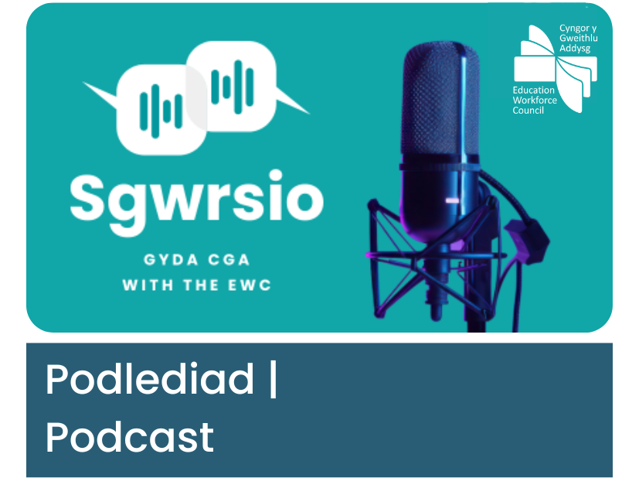

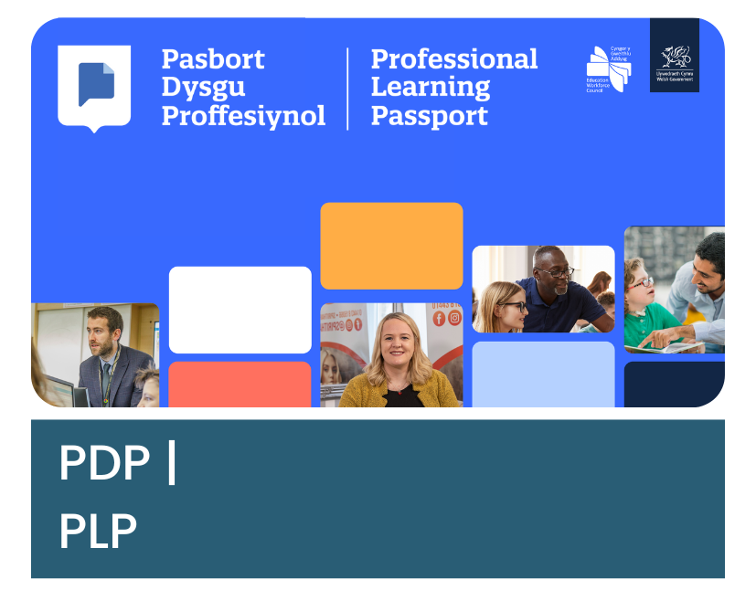


Canllawiau, adnoddau, a gwasanaethau proffesiynol
Guidance, resources, and professional services

Slide 33
Nia Griffith – Rheolwr Data
Ffôn – 029 2046 0099
E-bost – ystadegau@cga.cymru
Gwefan – www.cga.cymru
LinkedIn – Cyngor Gweithlu Addysg
Nia Griffith – Data Manager
Phone - 029 2046 0099
Email – statistics@ewc.wales
Website – www.ewc.wales
LinkedIn – Education Workforce Council

